Slide 1

Tech for Disaster Management
BY…

Slide 2

INTRODUCTION
Disasters can strike unexpectedly, leading to chaos and disorganization. Efficient disaster management is essential for minimizing loss of life and ensuring the safety of affected populations. Technology plays a crucial role in streamlining communication, coordinating resources, and guiding individuals to safety.

Slide 3
What is our objective?
To develop a system that provides real-time support for evacuation and resource distribution during disasters.
To utilize mapping technology and database management for efficient disaster response.

Slide 4
Overview: The "Tech for Disaster Management" project comprises two primary components:
Evacuation Route Finder: A tool to help individuals navigate safely to designated shelters or safe zones.
Water/Food Distribution System: A platform to manage and track the distribution of essential resources like water and food.

Slide 5
Key Features
Evacuation Route Finder: Real-time routing based on hazards.
Resource Distribution: Inventory management and needs assessment.

Slide 6
Evacuation Route Finder Objective: The evacuation route finder aims to assist individuals in identifying the safest and most efficient paths to safety during disasters.
Route Mapping: Utilizes mapping services to create routes.
Risk Factors: Integrates real-time hazard data, adjusting routes dynamically.
Notifications: Sends updates to users regarding route changes or hazards.

Slide 7
Water/Food Distribution System Objective: The distribution system is designed to ensure that essential resources like water and food are allocated effectively during disaster scenarios.
Resource Inventory: Maintains real-time data on available supplies.
Need Assessment: Evaluates areas of high demand to prioritize distribution.
Request Management: Allows users to request needed supplies directly through the platform.

Slide 8
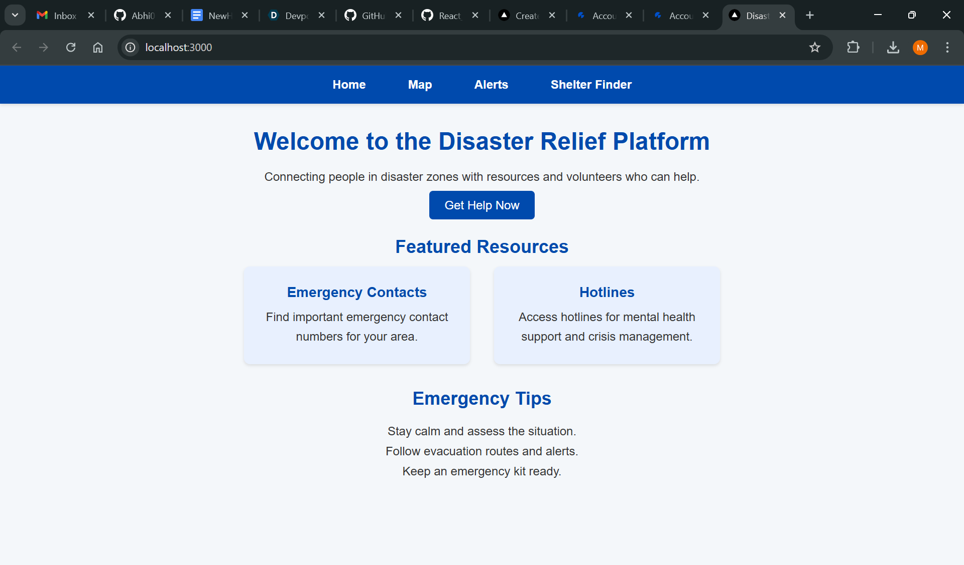
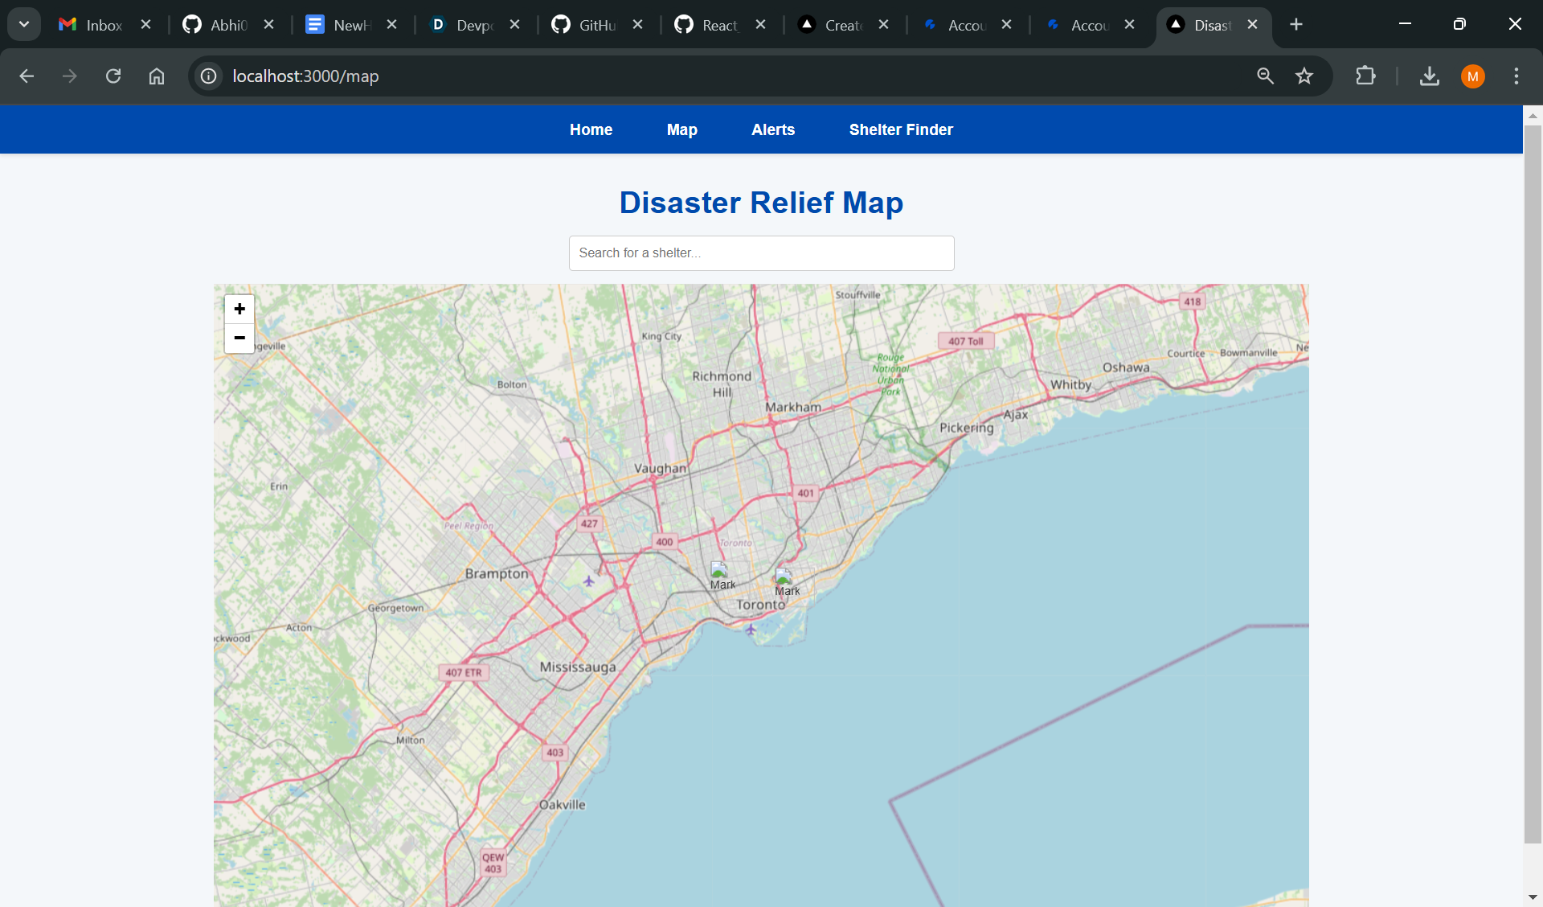
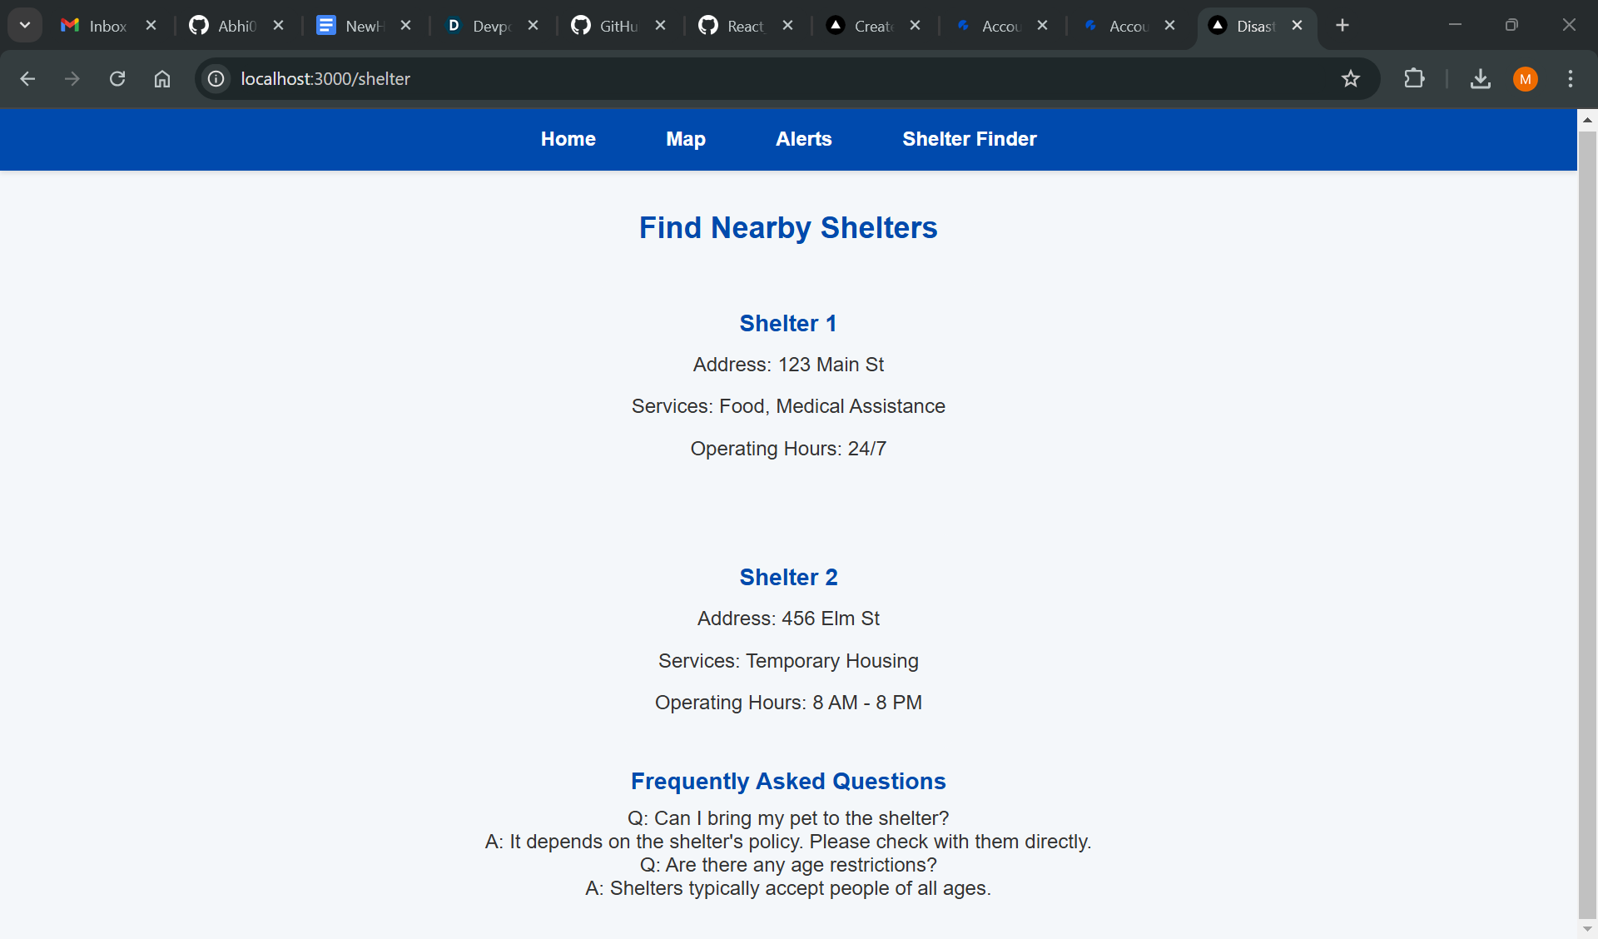
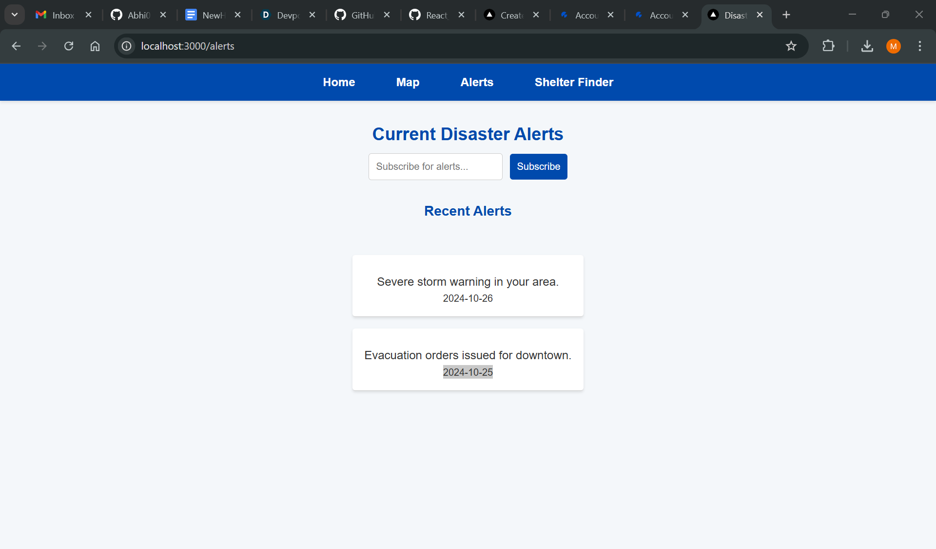

Slide 9

Integration of Features.
The evacuation route finder and distribution system are designed to work together seamlessly. For example, if a user is directed to an evacuation shelter, they can also see what resources (food, water) are available at that location.
Benefits
Real-time updates during evacuations can provide crucial information about available resources at safe zones.
Enhances situational awareness for both users and disaster response teams.

Slide 10
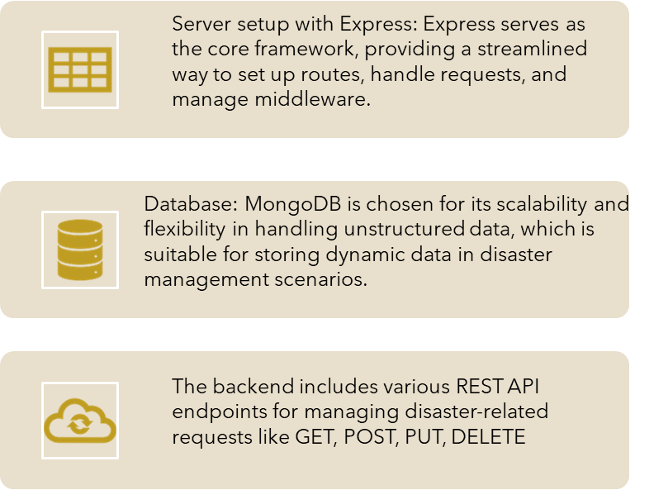
Technical Implementations
Frontend
backend
React: Core library for building the user interface.
The application uses React Router for client-side routing, enabling navigation between components without a full page reload.
For making HTTP requests to a backend API for fetching and manipulating data, specifically in InventoryRequest.

Slide 11
Challenges and Considerations
Data Accuracy: Ensuring real-time data is accurate and reliable can be challenging.
User Interface Design: Creating an intuitive interface that is easy to navigate during high-stress situations.
Internet Accessibility: Many disaster-affected areas may have limited internet access; consider offline capabilities.
Data Privacy: Ensure user data is securely handled and comply with relevant regulations.

Slide 12

How can we improve it in future?
Machine Learning: We can implement predictive algorithms to forecast resource needs based on historical data.
Mobile App: Develop a mobile application for easier access during emergencies.
Explore the possibility of expanding the system to cover additional geographical areas and disaster types (e.g., earthquakes, hurricanes).

Slide 13
Conclusion
The "Tech for Disaster Management" project aims to leverage technology to improve safety and resource management during disasters. By integrating an evacuation route finder with a resource distribution system, we can significantly enhance disaster response efforts.

